Slide 1
Approximate Closest Community Search in Networks
Xin Huang *, Laks V.S. Lakshmanan *
University of British Columbia
Jeffrey Xu Yu ^ , Hong Cheng ^
The Chinese University of Hong Kong
VLDB 2015
Tianzhu Wei
2016 – 11 - ???

Slide 2
Contents
Problem definition
Our solution
Experiments
Conclusion

Slide 3


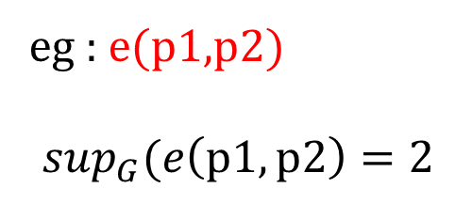
Problem definition
t
The support of an edge e(u , v) ∈ G
v2
v5
p1
$$\sup_{G}(e)$$
$$=|\left\{△_{uvw}:w∈V\right\}|$$
P2
q1
v1
v3
q3
eg : e(p1,p2)
$$\sup_{G}(e\left(p1,p2\right)=2$$
q2
v4
P3

Slide 4
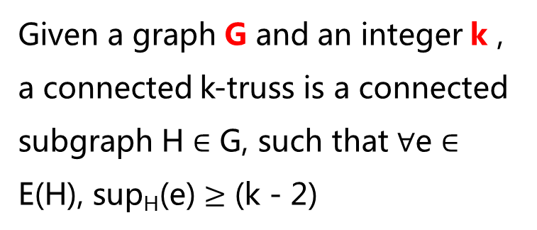
Problem definition
t
Conneceted K-Truss
v2
v5
p1
Given a graph G and an integer k , a connected k-truss is a connected subgraph H $∈$ G, such that $∀$e $∈$ E(H), sup_{H}(e) $≥$ (k - 2)
P2
q1
v1
v3
q3
q2
v4
P3
4 - Truss
Notes:
H这个子图满足其中的任意一条边的 support 值都大于（K-2）
这里举一个例子比如子图｛p1 p2 p3 q3｝这个子图，是一个 4-Truss
最小边的support值+2

Slide 5





Problem definition
t
Trussness
v2
v5
p1
$$\text{1.}\text{The} \text{trussness} \text{of} \text{a} \text{subgraph} \text{H} ⊆\text{G}$$
$$τ\left(H\right)=\min_{e∈E\left(H\right)}{\{sup}_{H}\left(e\right)\}+2$$
P2
q1
v1
v3
q3
$$\text{2.}\text{The} \text{trussness} \text{of} \text{a} edge$$
q2
v4
P3
$$τ\left(e\right)=\max_{H⊆G\&e∈E\left(H\right)}\{τ\left(H\right)\}$$
$$\text{3.}\text{The} \text{trussness} \text{of} \text{a} vertex$$
$$τ\left(v\right)=\max_{H⊆G\&v∈V\left(H\right)}\{τ\left(H\right)\}$$

Slide 6
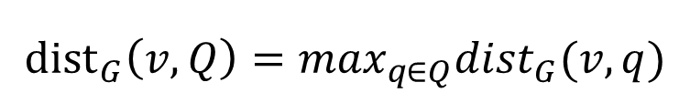
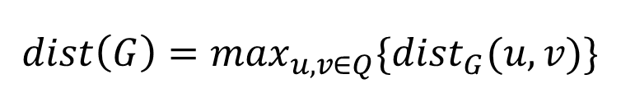
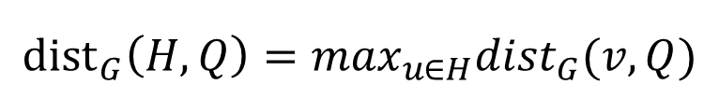
Problem definition
t
Query Distance
v2
v5
p1
$${dist}_{G}\left(v,Q\right)=\max_{q∈Q}{dist}_{G}(v,q)$$
$${dist}_{G}\left(H,Q\right)=\max_{u∈H}{dist}_{G}(v,Q)$$
P2
q1
v1
v3
q3
q2
v4
P3
Graph Diameter
$$dist\left(G\right)=\max_{u,v∈Q}{\{dist}_{G}(u,v)\}$$

Slide 7
Problem definition
Free Rider Effect
q1
p
r
v
q2
G2
G1
使用 Example 3 来进行举例说明 搭便车 影响

Slide 8
Problem definition
t
Closest Truss Community
v2
v5
p1
Connected k-Truss
G’is a connected k-truss containing Q
with the largest k;
P2
q1
v1
v3
q3
q2
v4
P3
2) Smallest Diameter
G’is a subgraph of smallest diameter satisfying condition (1)
Graph G
CTC-Problem : Given a graph $G(V,E)$ and a set of query vertices $Q=\{v_{1},…,v_{r}\}$ , find a closest truss community containing Q .

Slide 9
Our solution
t
Basic Algorithmic Framework
v2
v5
p1
P2
q1
v1
v3
q3
先找到 G0（满足查询结点中的最大 K-truss）
G0 可能有一个非常大的 图直径，所以我们需要找到一些点将这些“搭便车”的点删除
删除这些点之后可能使我们之前找到的子图不在满足 K-kruss 图的性质，这个时候我们就要进行维护了。
q2
v4
P3
设查询结点 为 q1 q2 q3
找到阴影的部分
然后找到一个距离查询结点最远的点 p1=4(或者 p2 p3)
然后删除这些点
删除之后可能会有一些边或者点不再满足 t-truss 性质了，所以我们就要进行维护了

Slide 10
Our solution
K-truss Identification and Maintenance
Find G0
Index Construction
v2
v3
之前找G0 是利用图分解的方法来进行的
让 K=3 开始进行循环，然后计算出每条边的 support 值，将support 值小于（k-2）的边删除，因为删除一条边可能对其它边的 support 值影响，所以我们要将可能影响的值进行一下更新
4
4
4
4
4
4
4
2
4
q1
q2
t1
t2
4
4
4
4
v1
v4
Q1 q2 是我们要查询的结点

Slide 11
Our solution
Fast Search Algorithmic

Slide 12
Our solution
Bulk Deletion Optimization

Slide 13
Our solution

Slide 14
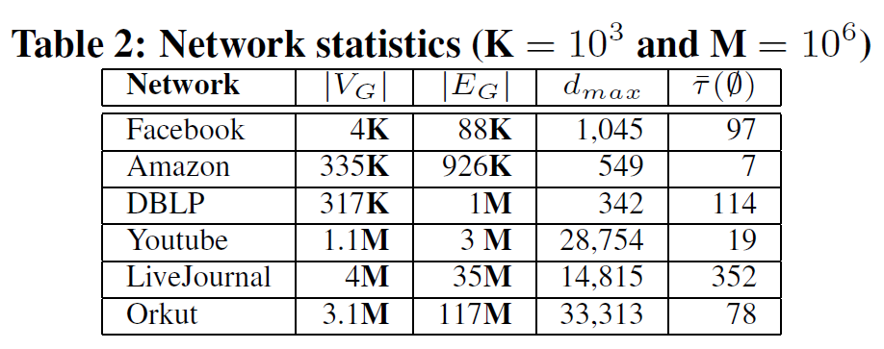
Experiments

Slide 15
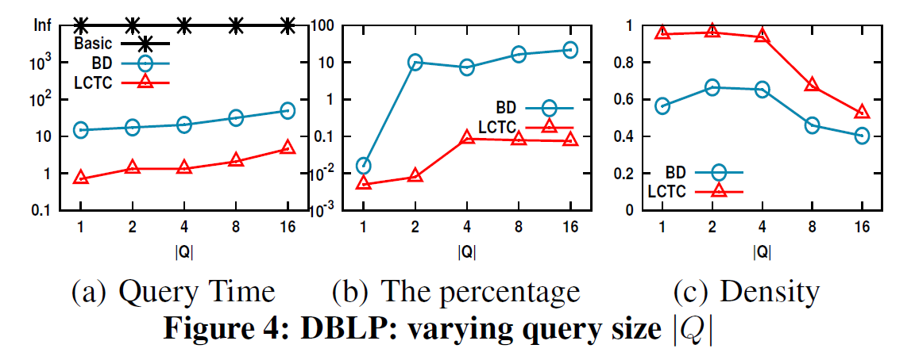
Experiments

Slide 16
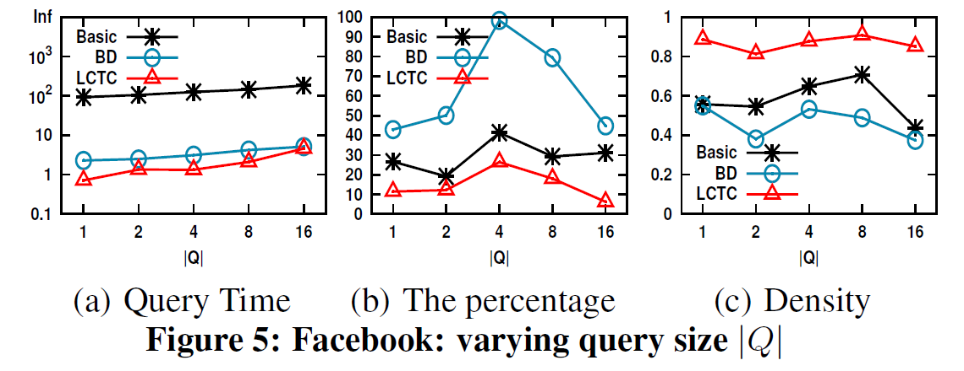
Experiments

Slide 17
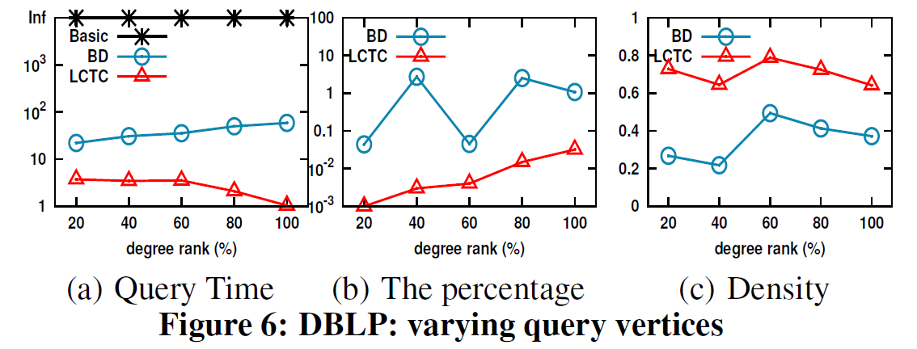
Experiments

Slide 18
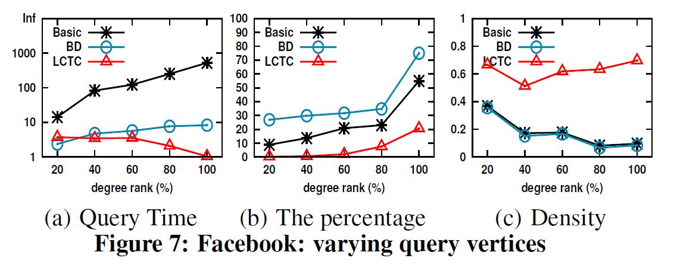
Experiments

Slide 19
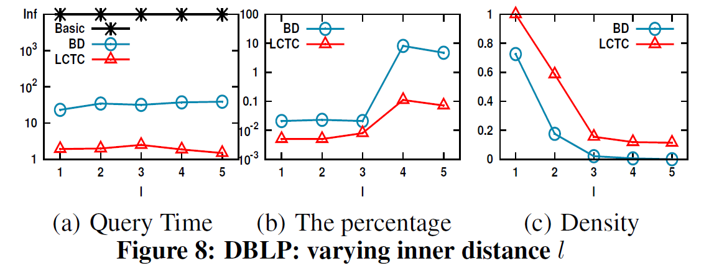
Experiments

Slide 20
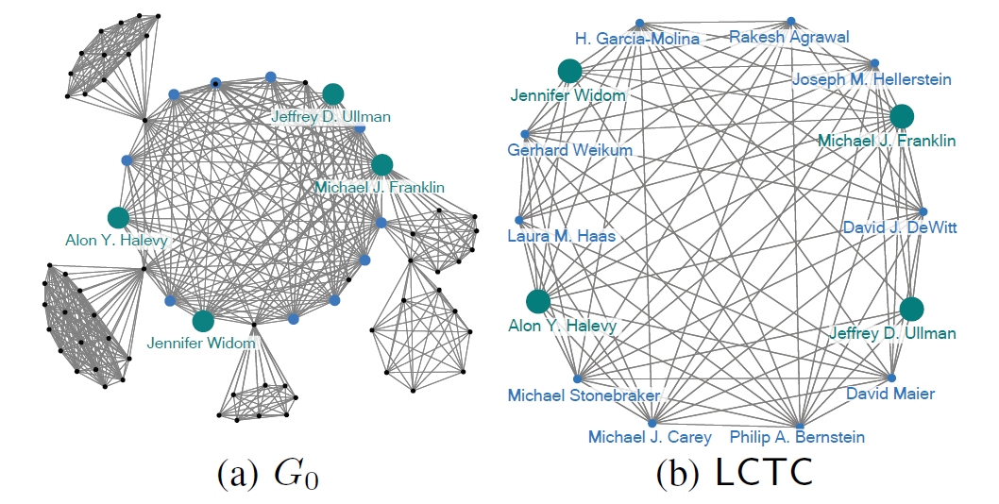
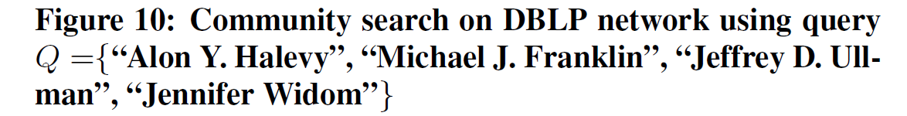
Experiments

Slide 21
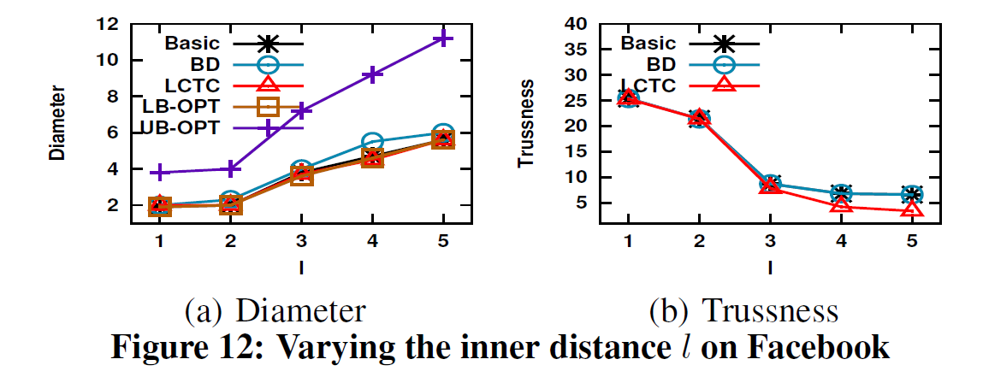
应该没用
Experiments

Slide 22
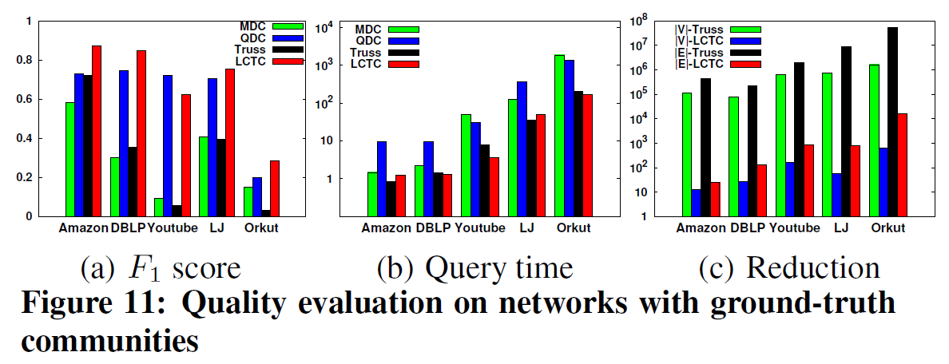
Experiments

Slide 23
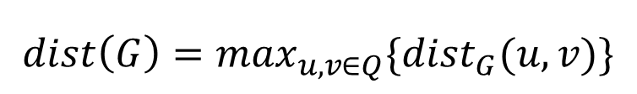
t
v2
v5
p1
P2
q1
v1
v3
q3
q2
v4
P3
$$dist\left(G\right)=\max_{u,v∈Q}{\{dist}_{G}(u,v)\}$$
Graph G

Slide 24
Thanks

